Slide 1

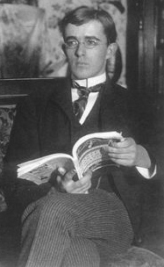
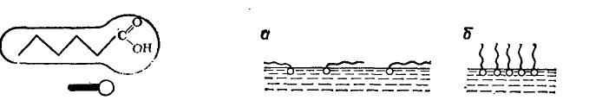
Lecture № 7. Langmuir monomolecular isotherm equation.
The Langmuir equation relates the coverage or adsorption of molecules on a solid surface to gas pressure or concentration of a medium above the solid surface at a fixed temperature. The equation was developed by Irving Langmuir in 1917.
Irving Langmuir
(1881-1957)
Adilbekova A.O

Slide 2
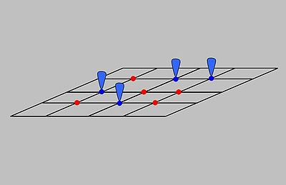



where γ₂ –number of surfactant molecules per 1cm² ;
N- Avogadro number;
Г₂ -total number of surfactant mols;

Slide 3


The fraction of surface occupied with surfactants is:
The another fraction or surfactant free surface is:

Slide 4
The rates of surfactant adsorption and desorption:

Slide 5
At equilibrium, the rates are equal, so:

Slide 6
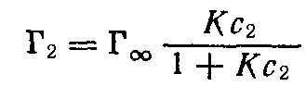
Using all previous equations, we get Langmuir adsorption isotherm equation :
K-equilibrium constant of adsorption process;
Г∞ - maximal adsorption

Slide 7
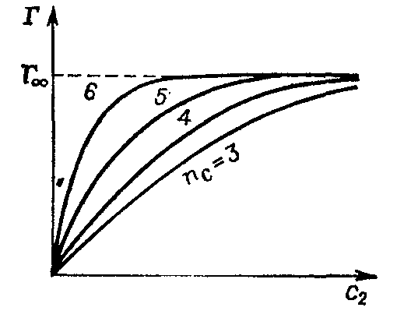





At the very low range of concentration
(c₂ ) the adsorption is linear and corresponds to Henry Law.
When the free surface is occupied totally, the adsorption will be equal to limited adsorption.

Slide 8



To find the constants, we can change Langmuir’s equation into linear form:
From the obtained K we can get a lot of information, like: cross section or the length of organic molecule.

Slide 9
Law of mass action
For a chemical reaction:
we can write chemical potential equilibrium:

Slide 11
А + В ↔ АB
с₀ – х с х
This equation is similar to Langmuir equation.

Slide 12
Could we use LMA for adsorption
at the gas – liquid interface?
- Work of adsorption

Slide 13
Traube rule.
Szуszkowski equation.
- адсорбция жұмысы
Szуszkowski equation
B – constant, K changes in homologous series
Szyszkowski equation

Slide 15
B – constant, K changes in homologous series
Szyszkowski equation

Slide 16
kJ/mol

Slide 17
Questions?
Thank you for your attention!

